Slide 1
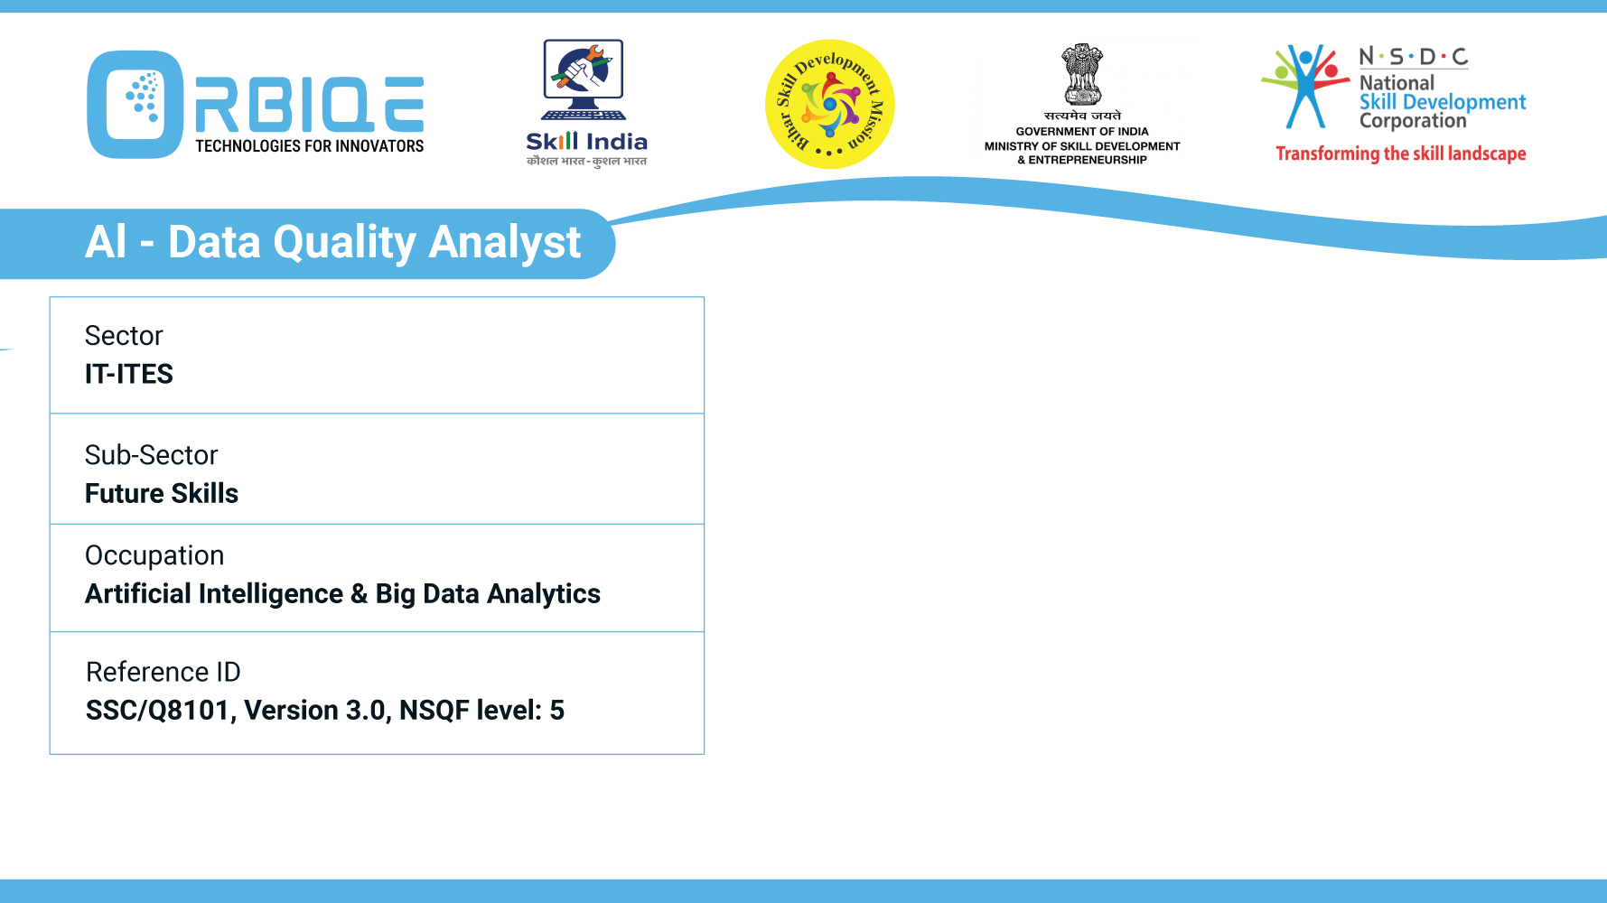
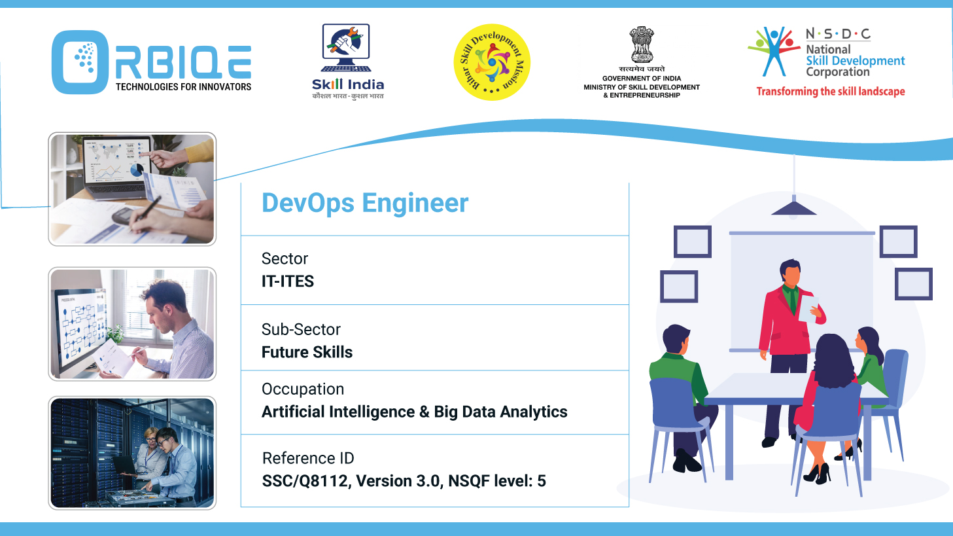
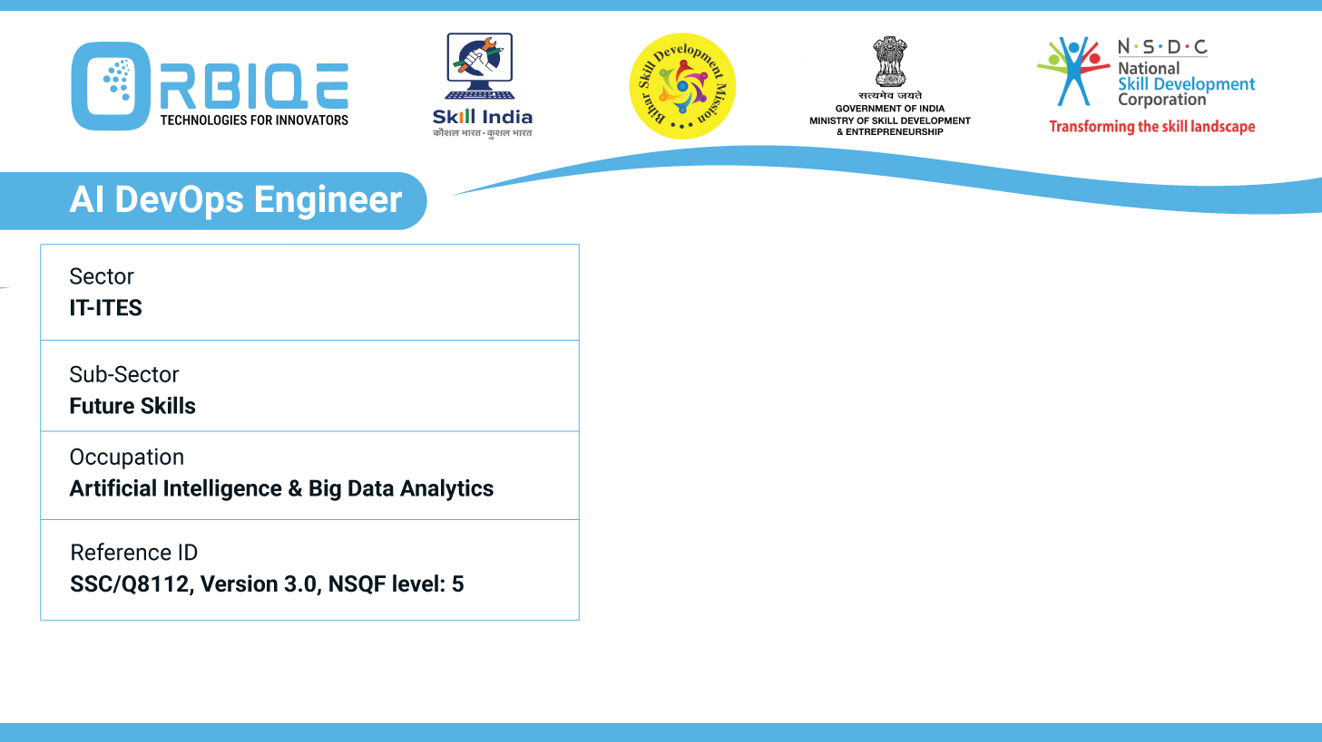
Name- Krishna Kant Dubey

Slide 2

Explain the basics of using statistical software packages and IDEs such as RStudio, Jupyter Notebooks

Slide 3
Agenda
Career map for roles in AI & Big Data Analytics
Differences Supervised Learning, Unsupervised Learning and Deep Learning“

Slide 4
RStudio: IDE for R Programming
Key Features:
Script Editor: Write and run R code.
Console: Execute commands interactively.
Environment Pane: View variables, data frames, and functions.
Plots Pane: Display charts and visualizations.
Packages Pane: Manage installed R packages.

Slide 5
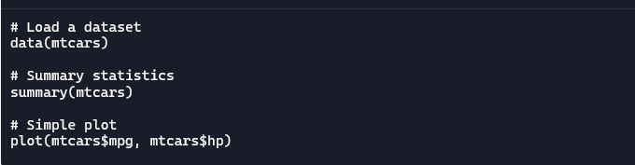
RStudio: IDE for R Programming

Slide 6
RStudio: IDE for R Programming
Package | Purpose
ggplot2 | Advanced data visualization
dplyr | Data manipulation
tidyr | Data cleaning
caret | Machine learning
shiny | Interactive web apps

Slide 7
Jupyter Notebooks: Interactive Python IDE
Code Cells: Run code interactively.
Markdown Cells: Add notes, documentation, and equations. Inline Visualizations: Display charts directly in the notebook.
Kernel Support: Run multiple languages (Python, R, Julia)

Slide 8
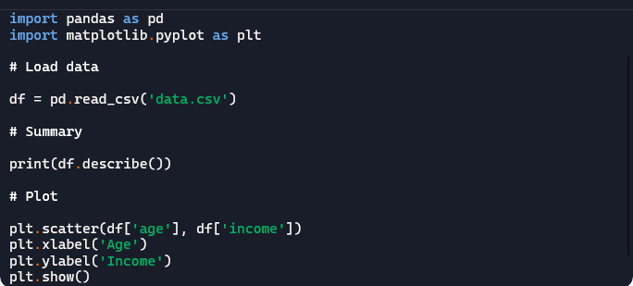
Jupyter Notebooks: Interactive Python IDE

Slide 9
Thank You

